Slide 1

SRM INSTITUTE OF SCIENCE AND TECHNOLOGY
SCHOOL OF COMPUTING
18CSP107L – Mini Project
Welcomes You All
‹#›

Slide 2

Student 1 Reg No: RA1811028010076
Batch ID: NWCO76
Guide name and Designation: Dr P Vigneshwaran, Associate Professor
SRM INSTITUTE OF SCIENCE AND TECHNOLOGY
FACULTY OF ENGINEERING AND TECHNOLOGY
DEPARTMENT OF NETWORKING AND COMMUNICATIONS
18CSP108L- MINOR PROJECT
REVIEW NO.2
REVIEW DATE:
Network Intrusion using a Neural network

Slide 3
Introduction
Networks are vulnerable to today’s techniques of penetration by hackers any attempt by an attacker is seen as an intrusion attempt as any further attacks like privilege escalation will occur only if the network has been intruded.
There are generally two ways of mapping an attack on a network
Passive: Attackers gain access to a network and can monitor or steal sensitive information, but without making any change to the data, leaving it intact.
Active: Attackers not only gain unauthorized access but also modify data, either deleting, encrypting or otherwise harming it.
Some common network attacks are
Distributed Denial of Service (DDoS) attacks
Insider threats
Man in the middle attacks
To prevent this there have been systems called Intrusion Detection system which detects these kinds of attacks and takes action like reporting to the owner of the network

Slide 4
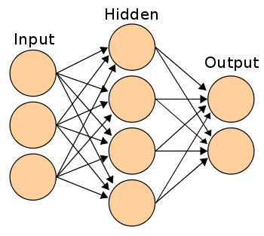
Algorithm used
Artificial neural network algorithm has been used in this work
Our work can contain many types of network attacks which may lead to a multi-class label
ANN’s are good in multi-class classification
ANN’s have three stages while processing

Slide 5
Module Description
Dataset
Removing null values Feature encoding and scaling
Feature selection
Testing the neural network with generating test data
Applying the data to the neural network
Splitting into train and test

Slide 6
Feature scaling and encoding
Feature scaling is a process used to reduce the values present in the feature column closer to the mean.
Values being far apart cause the model to perform inaccurate predictions.
Label encoding is used to convert the data type of the values of certain features.
For example in the dataset, the type of connection features may be set as UDP, TCP etc.
To help the algorithm understand these values are converted into numbers via encoding

Slide 7
Model settings
Setting | Option
Optimizer | Adam
Total Neurons | 17
HIdden layers | 1
Output neuron | 1
Epochs | 10 (after trial and error)
Activation function | ReLu, Sigmoid

Slide 8
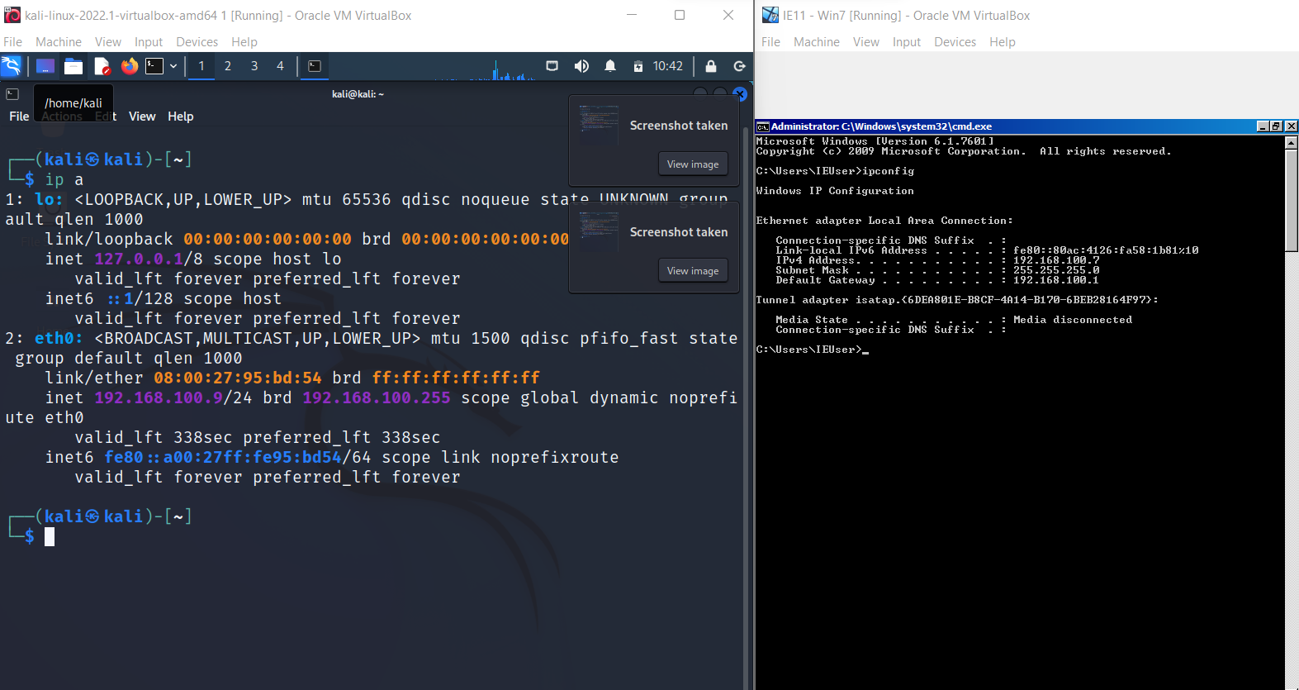
Appendix

Slide 9
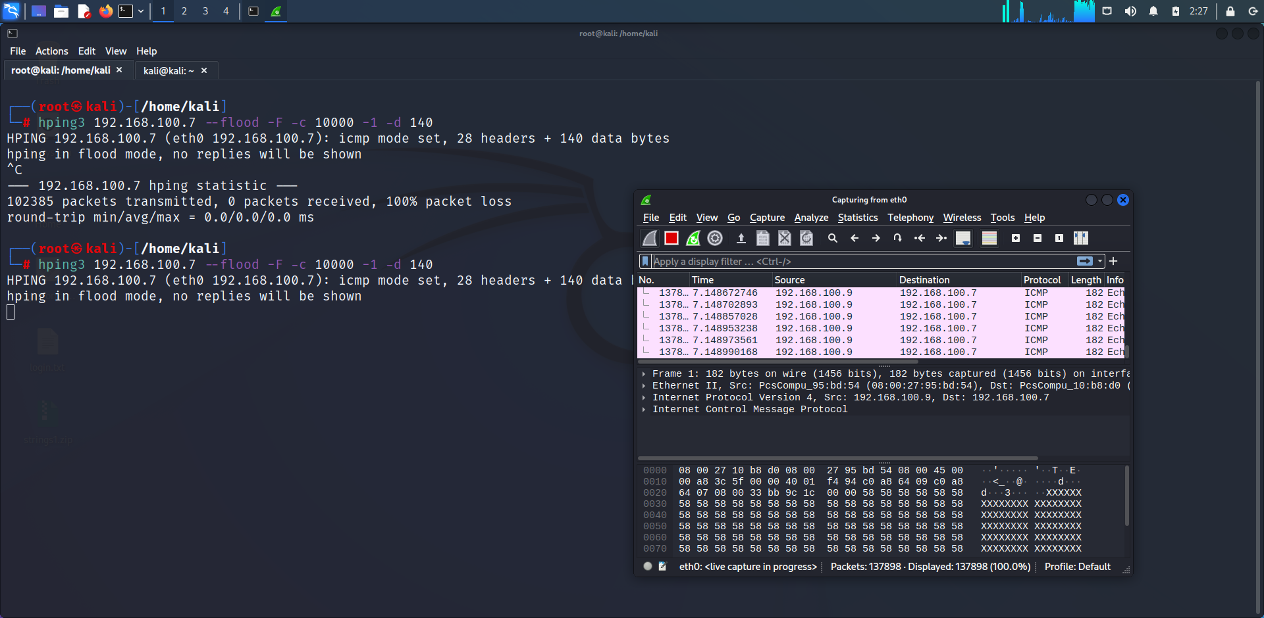

Slide 10
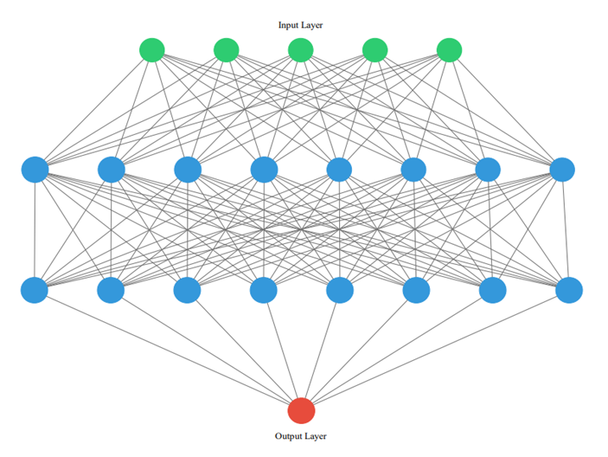
Appendix (Neural Network)

